Slide 1
TRUST IT!
Saul Larner, Ph.D., LL.M., MBA Presenter

Slide 2
How can I take my practice to the next level?
Booming market potentials
Increasing need for land trusts
Cross-Border Clients
Clients will seek you out
Elevate your professional status
Resolve transaction issues
Tax Curtailment strategies

Slide 3
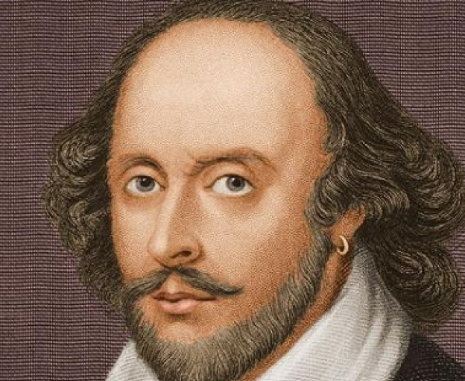
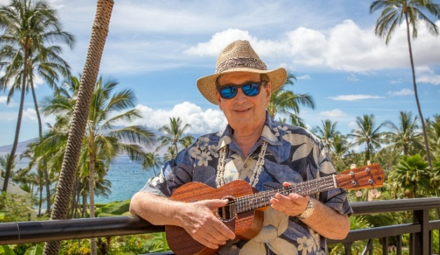
Our methodology
We first survey the plot,
Then draw the model
Then we must rate the cost of erection
Which if we find outweighs ability,
What we do then but draw a new model
William Shakespeare, King Henry 1V, Part 2
'Settlement is an Art"
Saul Larner, Ph.D., LL.M., MBA

Slide 4
WHAT IS A LAND TRUST?
IT IS
REALLY SIMPLE
It is a simple arrangement whereby a TRUSTEE holds title to real estate for the benefit of another party (TRUSTOR and/or BENEFICIARY ) .
TRUSTEE EXECUTES ALL DOCUMENTS FOR “BENEFICIAL OWNERS”

Slide 5
WHAT IS THE TRANSACTIONAL DIFFERENCE?
BENEFICIARY CHANGES INTEREST FROM
REAL PROPERTY TO PERSONAL PROPERTY .
BENEFICIAL INTEREST CAN BE SOLD, ASSIGNED
OR PLEDGED (AS REAL ESTATE CAN).
TRUSTEE TAKES INSTRUCTIONS FROM BENEFICIARY
BENEFICIARY HAS RIGHTS UNDER RECORDED TRUST DEED.
BENEFICIARY HAS RIGHT UNDER PROCEEDS.
TRANSFER INTERESTS WITHOUT TAX CONSEQUENCES.

Slide 6
HOW A LAND TRUST IS CREATED
Prepared, executed and given to trustee.
Trustee becomes holder of title. Beneficiary retains total control.
Grantor and Trustee sign deed of trust..Names beneficiaries and pro-rata shares.
Deed conveying title must be recorded.
Trustee will receive and retain all documents.

Slide 7
FINDING THE RIGHT ATTORNEY/ADVISOR
Ask about their practice and if they have the ability to successfully put together a trust for your client.
What are their fees? (A fixed fee is always preferable).
Does the attorney charge for phone consultations and how long is the timelag to return
calls?
What is the turnaround time to prepare the trust?
Does he suggest you attend the meetings?
Did you like his misdemeanor?
Did he seem knowledgeable?
Was he focused on you or did he seem distracted?
Does he seem likely to work with your team player colleagues?

Slide 8
SP LARNER Strategic Alliance Extended Team
Our Strategic Partners
Domestic Certified Public Accountant
International Tax Accountant
International Tax Attorney
International Investment Advisor
Family Law Attorney
Divorce
Planner
Private
Banker
Forensic
Experts
Foreign Currency Broker
Psychologist Social Worker
Immigration Attorney
Eb-5 Transaction Attorney
Mediator/ Arbitrator
ESOP Plan Specialist
Other
Specialists
Business Succession Specialists

Slide 9
BENEFITS OF THE ALOHA COMMITMENT TRUST
Your clients first and foremost—asset protection and confidentiality. He/she must know how .
this is achieved.
YOU MUST EDUCATE AND PROTECT YOUR CLIENT AND NOT MISLEAD THEM IF
THEY ARE TO RECEIVE THE BENEFITS.
This trust elevates to include gratitude, kindness. Compassion, love and peace.
Aloha is much more than a greeting and the decisions are driven by the client’s desires.
COMMITMENT IS MORE OFTEN KEPT BECAUSE BOTH PARTIES ENHANCE THEIR
COMMITMENT TO ONE ANOTHER..

Slide 10
BENEFIT 1: USE SHARES FOR COLLATERAL WHEN BORROWING
1. Every bank who understands land trusts knows that the assets cannot be
attached by creditors.
2. The bank can act as trustee for greater security.
3. Greater financial flexibility
A. Collateral assignment of beneficial interest
B. Substitute of collateral
C. Subordination

Slide 11
BENEFIT 2: PRIVACY AND SECRECY IN ACQUISITION
You can change beneficiaries and percentages.
All transactions are private.
Only the trustee’ name appears on the title.
You need not sign a witnessed deed.

Slide 12
BENEFIT 3: MARITAL DOCUMENTS SIGNED BY TRUSTEE
Divorce often requires prompt disposal of property
No delays or conflicts to deed of transfer because only the trustee’s signature is required as opposed to all of the owners and opposing counsel arguing.
.The advantages of confidentiality are being preserved.

Slide 13
BENEFIT 4: TRANSFER BY WRITTEN ASSIGNMENT-NOT DEED
Tie up property and move forward with a deed of trust before all details of Land Trust agreement have been decided.
Avoid title insurance, escrow and transfer fees.
Curtail property tax elevation
Curtail creditor garnishment.
Shorten 30 and 60 day closings
.The advantages of confidentiality are being preserved.

Slide 14
BENEFIT 5: ESTATE PLANNING FLEXIBILITY
TRUST CONTINUES FOLLOWING DEATH OF ONE OF THE BENEFICIARIES
ESTATE TAXES ARE NOT TRIGGERED
PEACE OF MIND
SATISFACTION
MINIMUM TAX
LIABILITY
LIFE ESTATE.

Slide 15
BENEFIT 6: CAPITAL GAINS TAX WILL NOT BE TRIGGERED
Capital gains tax will not be triggered and foreign tax credits will remain available if any capital gains tax is due after the property is sold.
(There are several variables relating
to potential tax liabilities)

Slide 16
BENEFIT 7: EASE IN SPLITTING ASSETS
There is an ease in splitting assets among family members for tax curtailment advantages.
In the case of estate taxes, the more the
family member owners, the greater the
tax exemptions.

Slide 17
BENEFIT 8: TRUST PLACEMENT NEGATES TAXATION
Placing property in the trust has no gift or income tax consequences.
Especially when placed in the Aloha Commitment Trust® as opposed to gifting the property to others which would trigger gift and/or
income taxes which can be avoided.

Slide 18
BENEFIT 9: CIRCUMVENT THE DUE ON SALE CLAUSE
1
Potential for lender to not discover the transfer of sale.
2
Requires that 100% of the beneficial interest be transferred
3
Easier to get waiver letter from lender
4
Convey from seller to trustee
5
Unrecorded assignment of beneficial interest
6
B Beneficial interest can be any personal property
7
World has no knowledge that buyer is now the 100% beneficiary.

Slide 19
BENEFIT 10: LOW PROFILE ON PUBLIC RECORD
The transactions pertaining to the property do not appear on public record with the Land Trust.
(due on sale clause is only one advantage)

Slide 20
BENEFIT 11: KEEP THE SALES PRICECONFIDENTIAL
Because no documents are recorded and thus no notice of sale to the assessor, the selling price
is confidential in nature.

Slide 21
BENEFIT 12: ELIMINATE TITLE INSURANCE TRANSFER COST
The existing title insurance policy remains in effect as long as the Land Trust is active.

Slide 22
BENEFIT 13: AVOIDS PROBATE
Probate avoids delay.
No lengthy tie-up of assets.
Estate taxes might not be assessed.
You can name the contingent beneficiaries in the land trust.
This avoids bequeathing your contingent assets under your will.
You can name these contingent beneficiaries in a 2nd revocable trust.
Executor fees are high..
Non residents of Hawaii can reduce state inheritance taxes.
Non residents probate reduction or elimination rules for non-residents
Terms of drafting 2nd revocable trust might eliminate federal income tax.

Slide 23
BENEFIT 14: LIMIT LENDER’S SECURITY AGAINST THE PROPERTY
Limit lenders’ security against the property against property and trust (unless guarantees have been signed.
(Trustee must sign under the name of the
trust, but add “not individually”

Slide 24
BENEFIT 15: TRUE LENDER CONFIDENTIALITY RE: TENANTS
Trust beneficiary name is not on the lease.
Therefore, tenant doesn’t know the name of the true owner.
Now, when “landlord negotiates with
tenant, “goodwill” is maintained.

Slide 25
BENEFIT 16: MAY BE DRAWN AS PARTNERSHIP OR JOINT VENTURE
Greater flexibility in creating capital structures.
Eliminate double taxation at spouse’s death.
Property owned jointly can be handled by
one of the owners. (death, incompetency,
etc.
.

Slide 26
BENEFIT 17: AN IRA CAN PURCHASE PROPERTY IN A LAND TRUST
Client may continue to preserve asset protection.
When the IRA owns part or all of the beneficial interest in the land trust, all of the advantages which are stated in this course can be preserved.
.

Slide 27
BENEFIT 17: A NEW BENEFICIARY MAY MAKE CHANGES
Interest rather than property is transferred.
New beneficial owner may wish to make changes for future generations.
This avoids creating separate entities.
.

Slide 28
BENEFIT 19: CHANGES ONLY NEED TO BE SIGNED BY BENEFICIARY
Beneficiary may amend his own documents.
Only beneficiary need to sign document.
Trustee signs transfers and minor tasks.
.

Slide 29
BENEFIT 20: NO DOCUMENTARY STAMPS UPON ASSIGNMENT.
Further, one saves on administrative and escrow fees.
Confidentiality is preserved because there is
No recording.
.

Slide 30
BENEFIT 21: CROSS BORDER CLIENTS MAY AVOID DOUBLE TAX
Double taxation is avoided because tax liability flows through to the individual level and tax credits are given by the CTA (Canadian Tax Authority).
The Land Trust avoids being taxed as a
corporation.
.

Slide 31
BENEFIT 22: SPLIT OWNERSHIP NOW TO MINIMIZE TAXES LATER
You must use living trust or land trust to split ownership (an irrevocable trust will not work).
However, the living trust will not provide
asset protection.
.

Slide 32
BENEFIT 23: PLANNING TO DISTRIBUTE ALL PROPERTY AT DEATH
You must use living trust or land trust to split ownership (an irrevocable trust will not work).
However, the Land Trust has asset protection
potential and estate tax curtailment
strategies.
.

Slide 33
BENEFIT 24: THE LAND TRUST IS INEXPENSIVE TO IMPLEMENT
The Land Trust has many advantages found only in trusts which are formed, such as an irrevocable trust.
.

Slide 34
BENEFIT 25: A REGISTERED AGENT IS NOT REQUIRED
A registered agent is not required as in a corporation.
Therefore, the client doesn’t have to pay
an attorney to act as one.
You may use anyone as your trustee.
.

Slide 35
BENEFIT 26: PROPERTY IS EASIER TO FORECLOSE UPON
Beneficiary sells his beneficial interest in the land trust rather than taking back a contract for deed.
Buyer defaults.
3. Personal property-- U.C.C rules apply.
.

Slide 36
BENEFIT 27: EASE IN OPERATING ACROSS STATE LINES
No federal trust law.
1
Full faith and credit law reciprocity
2
Use state other than your situs.
3
Apply for federal jurisdiction in litigation matters.
4
Out of state structures create confusion
5
“Settlement is an Art”
6

Slide 37
BENEFIT 28: STOP ADVERSARIES FROM CONTRACT INTERFERENCE
1. The power of direction to a Land Trust is assigning irrevocably to an out of state entity.
2. The court cannot direct the trustee to sell the property and assign the beneficial interest to
satisfy a creditor claim.
.

Slide 38
BENEFIT 29: AVOID IDENTITY THEFT OF NAME AND SIGNATURE
No signatures are made public
.

Slide 39
BENEFIT 30: NO PERSONAL CREDIT REPORTING
This keeps debts off the beneficiary’s
credit report.
.c

Slide 40
BENEFIT 31: SPOUSE NEED SIGN FOR PROPERTY TRANSFERS
A spouse doesn’t need to join in the assignment of the transferred property for purposes of releasing the other spouse’s homestead rights.
Because the property is now personal
property so it it is assignable without
acknowledgment of deed.

Slide 41
BENEFIT 32: PROTECTION FROM HOMEOWNER’S ISSUES
Judgment against a beneficiary does not constitute real estate lien.
1
None of the property owner’s names are on title.
2
Signatures from all parts of the world are not required.
3
No power of attorney form to contest.
4
Avoidance of dower interest.
5
Therefore, wife doesn’t have to go to every closing to sign.
6

Slide 42
BENEFIT 33: DISPOSING OF PART ISSUES
Disposing of a part interest is simple because the transfer is by assignment and not by deed.
This avoids a deed’s formal requirements concerning acknowledgment, recording, and
joinder by the grantor’s spouse. (Watch
for transfer tax potentials).

Slide 43
BENEFIT 34: A LAND TRUST IS EASY TO CREATE
1. Simply sign a simple, short form agreement before or after the real
estate is acquired.
2. As owner, direct a corporate fiduciary to hold title to the real estate.
3. Direct and instruct fiduciary as to whom will have authority
to manage and control, when and to whom to be sold, and
who will become owner upon death.

Slide 44
BENEFIT 35: PROTECT AGAINST UNFORESEEN CIRCUMSTANCES
This protocol creates confidence in a buyer under an agreement to sell/buy.
Seller instructs trustee to convey title to
buyer upon full purchase price payment.
This protects buyer if seller dies, files
bankruptcy, etc.
3. In Land Trust it cannot be attached.

Slide 45
BENEFIT 36: AVOID PROBATE IN HOME STATE OR COUNTRY
Look to see if the Land Trust provides for contingent beneficiaries or if the ownership is assigned to a second revocable trust (as we viewed prior).___________________________
THE NON-RESIDENT CREATOR MAY
RETAIN FULL CONTROL OF THE
BENEFICIAL INTEREST IN THE LAND
TRUST.

Slide 46
BENEFIT 37: LAND TRUST “GIFT BANK” FOR ANNUAL EXCLUSION
The IRS is trying to eliminate this feature.
The land trust can be used as a “gift bank” by holding the annual gift exclusion to decrease
the gross estate and the taxable income of
the owner.

Slide 47
BENEFIT 38: LAND TRUST CERTIFICATES WITH NO DEFINITE TERM
Bonds are written usually with a 20 year term.
(Look for the rule of perpetuities)

Slide 48
BENEFIT 39: FORMATION OF A BUY-SELL AGREEMENT
Every Land Trust which is owned by multiple parties should be accompanied by a buy-sell agreement to determine the manner and under what circumstances the owners may or must
sell their interests, as well as the other
aspects of their mutual rights and
obligations among each other.

Slide 49
BENEFIT 40: JUDGMENT PROOF YOUR PROPERTY
The lien of a judgment debtor cannot attach to the assets of the Land Trust..
Trustee is not normally liable for debts as he signs using the “exculpatory clause” to eliminate personal liability.
Beneficiary will also be immune if he master minds a capital structure where the lender will forego a personal signature.
If property is of “sterling quality”, lender may loan money on the trust itself without a personal guarantee. (No recourse financing).

Slide 50
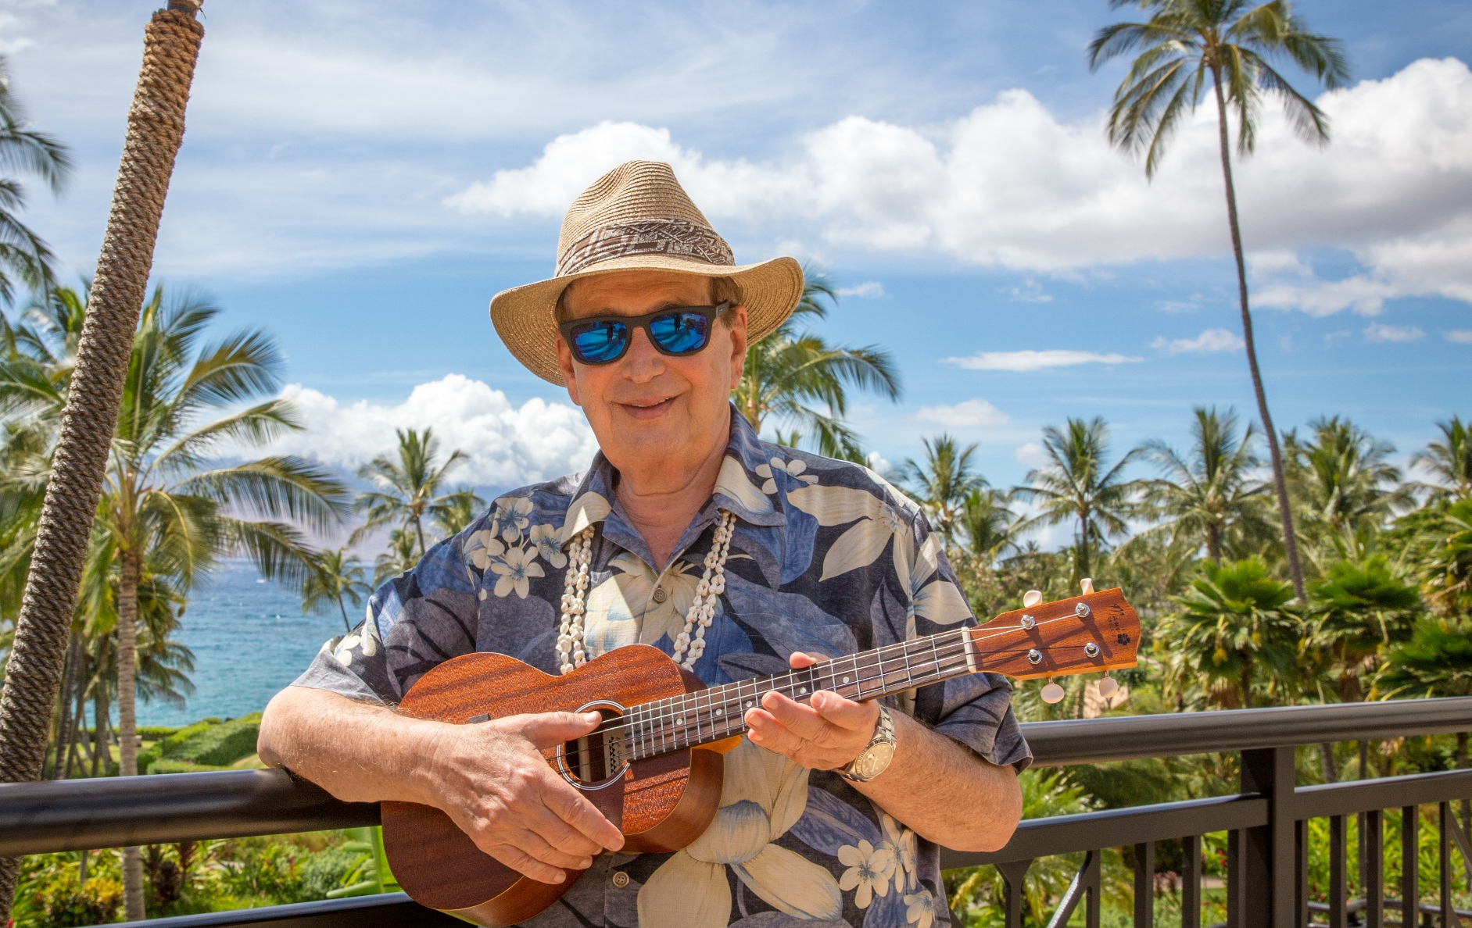
MAHALO
NUI
LOA

